Slide 1
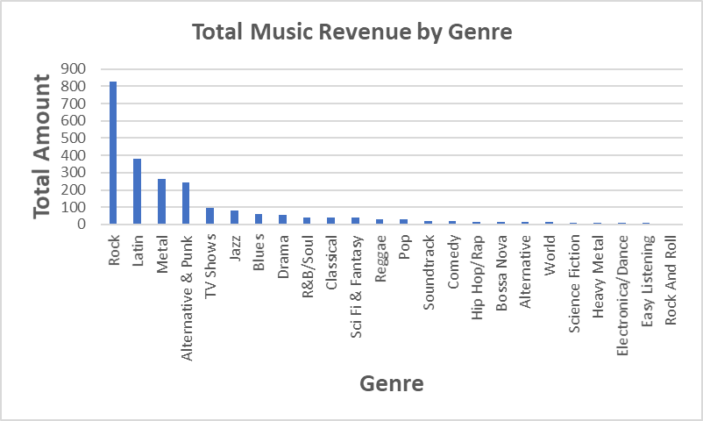
1. What is the most popular music genre (the one with the highest total sales)? what are the overall sales figures for each musical genre?
Rock music has the highest sales revenue with more than $800, followed by Latin music with less than $400, while the majority of other music genres have extremely modest sales.

Slide 2
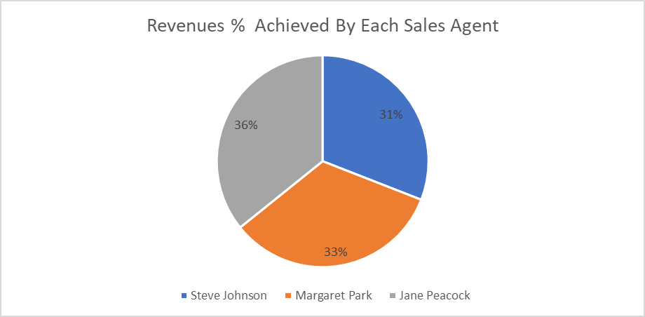
2. Write a query that returns the percentage contribution of each sales agent in the earned revenues?
Jane Peacock has the largest share (percentage) of achieved revenues (36%), but the figures show also that all are quite close to each other.

Slide 3
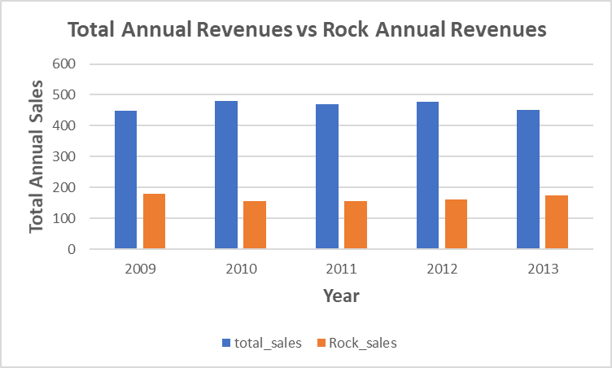
3. show the changes in annual total sales of all genres compared to the annual sales of the most demanded genre (which is 'Rock music') throughout all business years
Total annual revenues have been nearly steady over years of business, with only a tiny fluctuation in revenue, and the percentage of the most popular genre of music (Rock) in this income has likewise been relatively steady, with only a minor change from year to year.

Slide 4
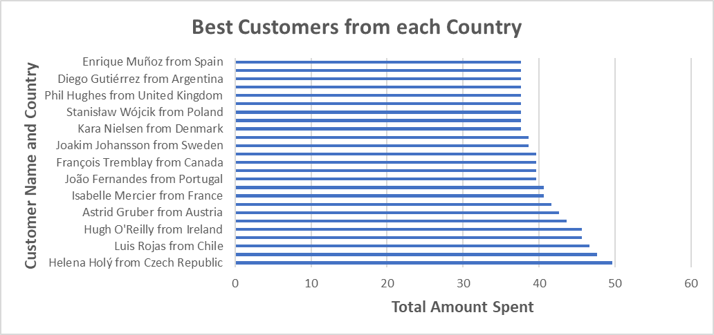
4. define the customer who has spent the most on music for each country, as well as how much each of them has spent?
Helena Holy from the Czech Republic has spent the most money (best customer). There are two customers from the United Kingdom that have the same spending score.

